Slide 1
SAGE Test Administration
2014-15
Karen Tohinaka
CBT Specialist
(SAGE Interim/Summative/Utah Compose/DLM) ph# (385)646-4168
kttohinaka@graniteschools.org

Slide 2
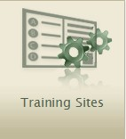
Accessing the Test Administrator Interface
Go to the portal at sageportal.org.
Click the [SAGE Live Test Administration] or [Training Sites] icon.

Slide 3
Accessing the Test Administrator Interface
Test Administrator Interface: Operational
Test Administrator Interface: Training Site

Slide 4
Test Administrator Home Page
After you log in, you will see the home page of the TA Interface.
Which tests are you administering? Interim or Mid-year Summative?
Figure 1. Before Starting a Test Session
Figure 2. After Starting a Test Session

Slide 5
Starting a Test
You must start a test session before students can log in to test. Choose the correct test! Interim or Summative??
All tests that students will be taking must be included.
Tests can be selected by clicking in the box in the upper left corner of the screen.

Slide 6
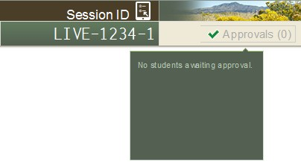
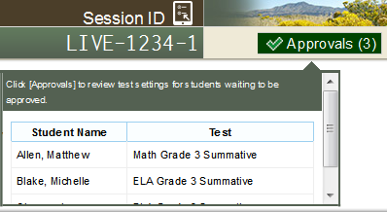
Viewing Student Test Settings and Approvals
[Approvals] button is not clickable.
[Approvals] button says “[Approvals (0)].”
Preview table says “No students awaiting approval.”
[Approvals] button is clickable
[Approvals] button says “[Approvals (#)].”
Preview table lists each student and his or her
selected test.
6

Slide 7
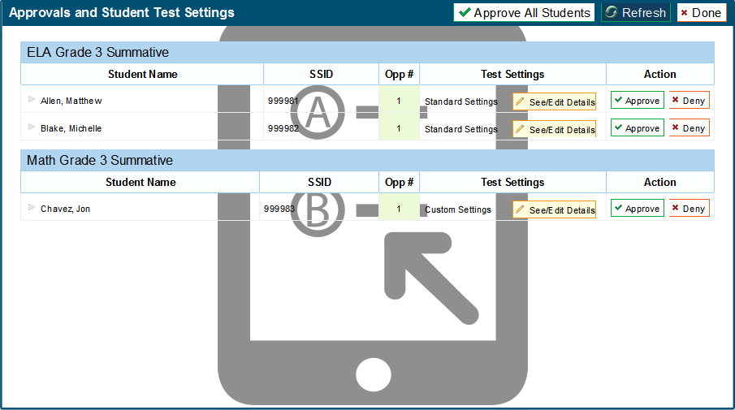
Approving Students

Slide 8
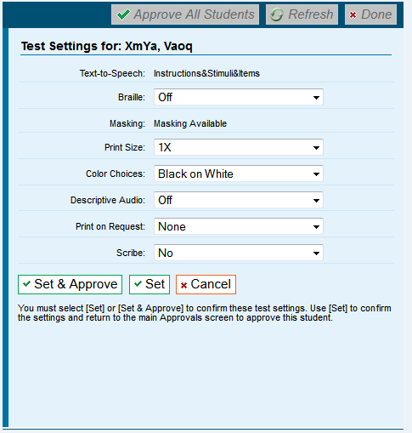
Test Settings and Accommodations
Confirm or select settings.
Click [Set] to confirm the selected test settings and return to the list of students awaiting approval. You will still have to approve the student for testing.
Click [Set & Approve] to establish the updated settings and approve the student for testing.
Click [Cancel] if you want to return to the Approvals and Student Test Settings screen.
8

Slide 9
Test Administrator Home Page
9

Slide 10
Monitoring Student Progress
The “Students in Your Test Session” table displays each logged in and approved student.
10

Slide 11
Monitoring Student Progress: Student Statuses
Status | Description
Approved | The Test Administrator has approved the student for the session, but the student has not yet started or resumed the test.
Started (#/#) | The student has started testing. The number after this status indicates how many items the student has answered out of the total number of items on the test. This number does not indicate which item or item page the student is actively viewing.
Review | The student has answered all items and is currently reviewing his or her answers before submitting the test for scoring. Note: A test with a review status occurs only at the end of the test. A test is not “completed” until the student submits the test.
Completed | The student has submitted the test. No additional action can be taken by the student.

Slide 12
Monitoring Student Progress: Student Statuses
Status | Description
Submitted | The test has been submitted for quality assurance review, validation, and overall scoring.
Denied | The Test Administrator denied the student entry into the session. If the student attempts to enter the session again, this status will change to “Pending” until the Test Administrator approves or denies the student.
Paused (#/#) | The student’s test is currently paused. The time listed with this status indicates how long the student’s test has been in the paused status.
Pending | The student is awaiting Test Administrator approval for a new test opportunity.
Suspended | The student is awaiting Test Administrator approval to resume a test opportunity.

Slide 13
Stopping/Pausing Tests
Through the TA Interface, Test Administrators may:
Stop an entire session; or
Pause (logout) individual student tests.

Slide 14
Stopping Tests: Entire Session
To stop the session (and pause tests for all students in the session):
– Click the [Stop Session] button in the upper left corner of the screen. An “Important!” box will appear, requesting verification to end the session and log students out.
– Click [OK] to continue or [Cancel] to keep the test session open.
Stopping a session will automatically pause all students’ tests in that session, and the students will be logged out automatically. The students can easily resume their tests once the TA has created a new session containing the appropriate tests.

Slide 15
Pausing Tests: Individual Students
Pausing an individual student’s test will pause only that student’s test.
Only that student will be logged out automatically.
That student can easily resume their test by requesting entry into the same session again, provided the session is still active.

Slide 16
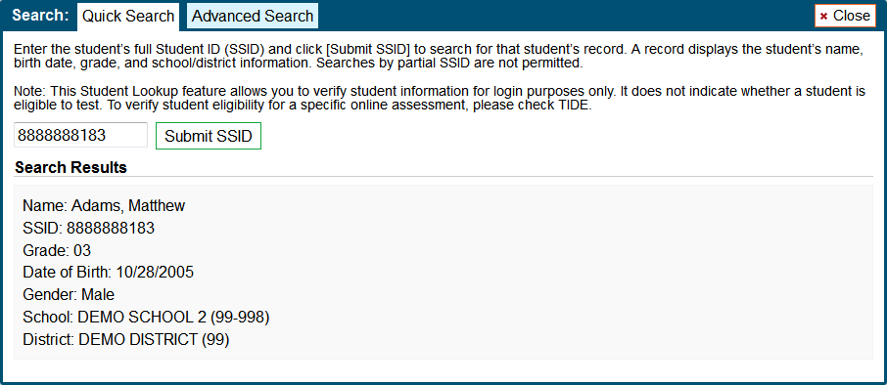
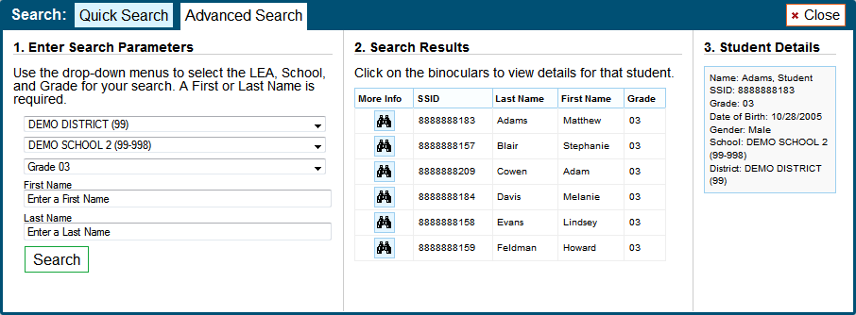
Student Lookup Feature

Slide 17
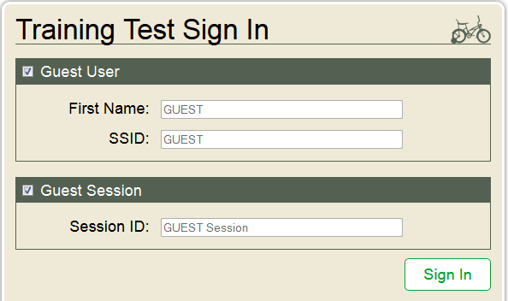
Training Tests
Experience the SAGE assessment as a student by taking
one of the training tests in a proctored session:
Either open the secure browser or go to the sageportal.org and click the [Training Tests] icon.
Uncheck the Guest Session box.
Enter the Session ID provided by the trainer.

Slide 18
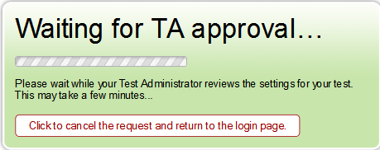
Training Tests
Click on one of the active tests.
Wait for approval to begin.
Once your request is approved, verify the information and start the test.

